Slide 1

Exploration method for Monte- Carlo
Notes:
1

Slide 2
Objectives
Understand why exploring starts can be problematic in real problems
Describe an alternative exploration method for Monte-Carlo control
Exploration methods for Monte Carlo
2
Notes:
2

Slide 3
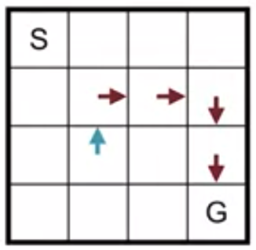
Exploration for Monte-Carlo
We can not always use Exploring Starts.
The situations where we cannot use exploring starts this algorithm must be able to start from every possible State action pair.
Otherwise the age of may not explore enough and could converge to a suboptimal solution in many problems.
It can be difficult to randomly sample an initial State action pair.
Exploration methods for Monte Carlo
3
Notes:
3

Slide 4

Exploration for Monte-Carlo
Example: how would you randomly sample the initial State action pair for a self-driving car?
How could we ensure the agent can start in all possible States?
We would need to put the car in many different configurations in the middle of a busy freeway.
This would be dangerous and impractical.
Exploration methods for Monte Carlo
4
Notes:
4

Slide 5
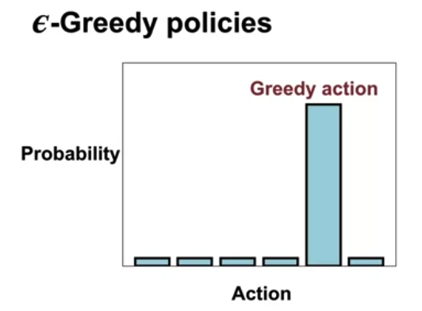
Exploration for Monte-Carlo
How can we learn all the action values without exploring starts?
We can use the Bandit with Monte Carlo to as a quick recap Epsilon greedy policies are stochastic policies.
They usually take the greedy action, but occasionally take a random action.
Exploration methods for Monte Carlo
5
Notes:
5

Slide 6
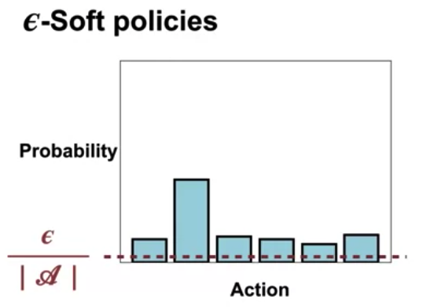
Exploration for Monte-Carlo
Epsilon greedy policies are a subset of a larger class of policies called Epsilon soft policies Epsilon soft policies take each action with probability at least Epsilon over the number of actions.
Exploration methods for Monte Carlo
6
Notes:
6

Slide 7
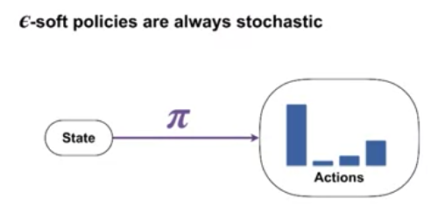
Epsilon- Soft Policies
Epsilon soft policies are always stochastic deterministic policy specify a single action to take in each state stochastic policies instead specify the probability of taking action in each state in epsilon.
All actions have a probability of at least Epsilon over the number of actions.
Exploration methods for Monte Carlo
7
Notes:
7

Slide 8
Epsilon- Soft Policies
Example of an Epsilon greedy policy and a deterministic policy.
We have a grid rolled with the arrows representing the deterministic policy.
From the start State the agent will follow the exact same trajectory through the grip world.
Exploration methods for Monte Carlo
8
Notes:
8

Slide 9
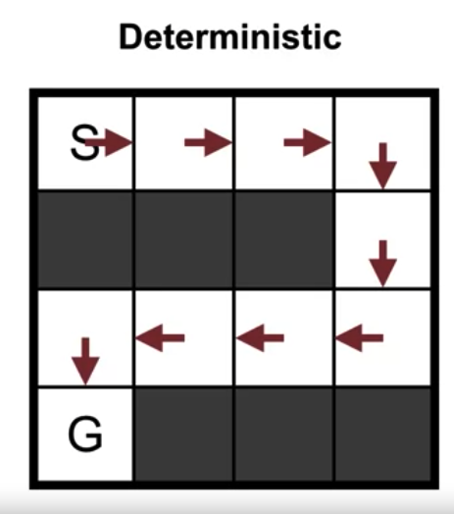
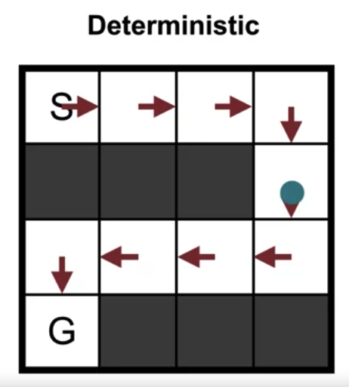
Epsilon- Soft Policies
Exploration methods for Monte Carlo
9
Notes:
9

Slide 10
Epsilon- Soft Policies
The Epsilon greedy policy has more arrows because every action has some small probability of being selected accordingly.
The agent will probably follow a slightly different trajectory every episode.
Exploration methods for Monte Carlo
10
Notes:
10

Slide 11
Exploration for Monte-Carlo
The Epsilon greedy policy has more arrows because every action has some small probability of being selected accordingly. The agent will probably follow a slightly different trajectory every episode.
Exploration methods for Monte Carlo
11
Notes:
11

Slide 12
Summary
Understand why exploring starts can be problematic in real problems
Describe an alternative exploration method for Monte-Carlo control
Exploration methods for Monte Carlo
12

Slide 13
Q & A
Exploration methods for Monte Carlo
13

